Slide 1

The eGaN® FET Journey Continues
PSMA Power Technology Roadmap
Alex Lidow, CEO Efficient Power Conversion Corporation
October 2012

Slide 2
Agenda
GaN Business Overview
What Impacts the Adoption Rate
Making GaN Easy to Use Now and In the Future
New Applications for GaN
Cost Roadmaps and Comparisons
Reliability
Summary

Slide 3
Business Overview
Notes:
Served Available Market Size and Growth
GaN Market Projections and Revenue Growth

Slide 4
Served Available Market (SAM)
EPC’s initial product
Power FET
(up to 200V)
$4.6B
Power FET
(over 200V)
$1.7B
IGBT modules
$2.3B
RF/Microwave
$1.3B
Mostly 600 V
Bipolar
$970M
IGBTs
$878M
Bipolar Modules
$49M
FET Modules
$232M
Source: IC Insights
Total = $12B in 2015

Slide 5
Power ICs Add to the SAM
Source: Yole Development
Total = $18B in 2015

Slide 6
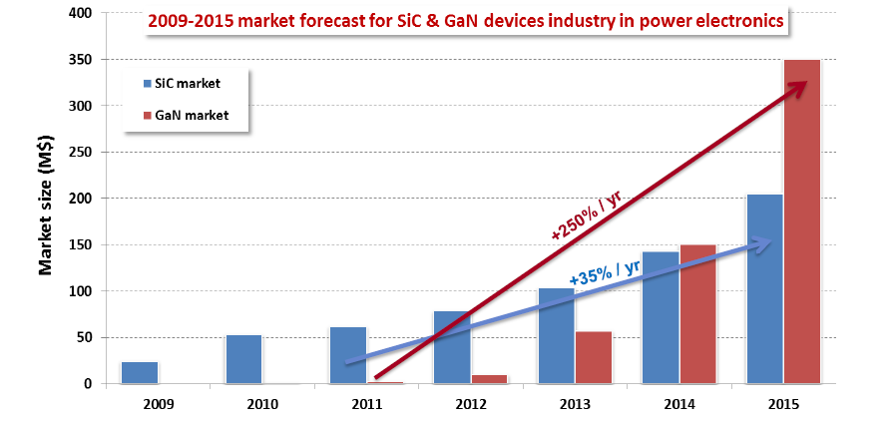
GaN Market Projection
EPC believes these projections are too optimistic and that 2015 GaN revenues will be less than $100M including RF
Source: Yole Development

Slide 7
Adoption

Slide 8
What Controls Adoption?
Make GaN Devices Easy to Use
Develop Applications beyond Silicon’s Capabilities
Make GaN Cost Effective
Establish GaN’s Reliability
Notes:
In the 1980’s the Power MOSFET replaced the bipolar transistor. This technology conversion taught us that there are four key activities that will drive the rate of adoption of GaN technology.

Slide 9
Making GaN Easy to Use
Notes:
Enhancement Mode eGaN FETs are just like MOSFETs
Develop an ecosystem of strategic partners and compatible products
Supporting University Research
PhD –Level Applications Engineering
Training Engineers through Applications and Seminars
The first GaN Transistor Textbook
Demonstration Boards and Development Kits
Highly Experienced Field Applications Engineering for customer training
Monolithic GaN ICs

Slide 10
Is an eGaN® FET easy to use?
It’s just like a MOSFET
except
The high frequency capability makes circuits using eGaN FETs sensitive to layout
The lower V_{G(MAX)} of 6 V makes it advisable to have V_{GS} regulation in your gate drive circuitry

Slide 11
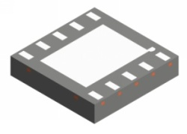
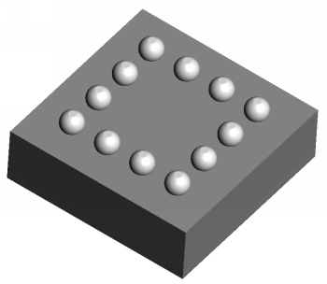
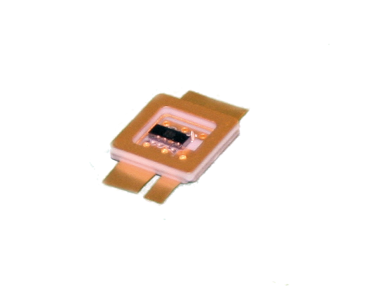
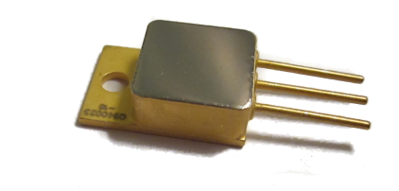
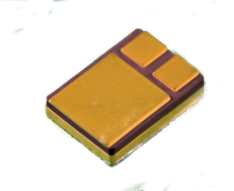
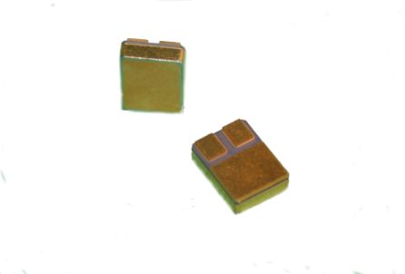
Ecosystem Development
Texas Instruments
  Driver ICs and multi-chip modules
Microsemi
  Hi Rel and Radiation Hard Transistors
Notes:
With the help of Texas Instruments and Microsemi, EPC is developing the infrastructure needed to make the application of eGaN FETs as easy as power MOSFETs. EPC continues to develop additional IC partners.

Slide 12
Universities With GaN Programs
Universities all over the world are graduating well-trained engineers experienced in the use of eGaN FETs.
University of California at Santa Barbara
Virginia Polytechnic University
Renssalaer Polytechnic Institute
Hong Kong University of Science and Technology
Cornell University
Katholieke Universiteit Leuven
University of Bristol
University of Glasgow
University of Sheffield
University of Warsaw
University of Sydney
Massachusetts Institute of Technology
Cambridge University
National Central University of Taiwan
Notes:
Focus on Power Management
Maintain a technological lead with enhancement mode (normally OFF) devices
Build a deep IP portfolio
Leverage the existing silicon CMOS low-cost supply chain.
Develop strategic partnerships that establish eGaN technology as the de facto standard.

Slide 13
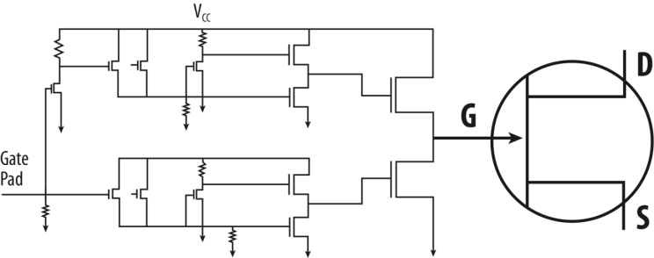
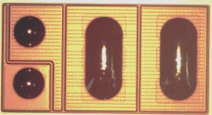
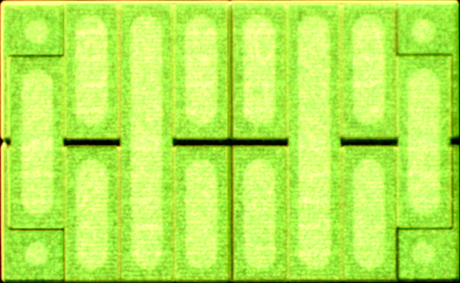
Beyond Discrete Devices
Driver On Board
Discrete FET with Driver
Full-Bridge with Driver and Level Shift

Slide 14
What Other Advances are Needed?
High speed digital controller ICs and integrated controller/driver ICs.
  Application specific controllers to reduce time-to-market
  Dynamic deadtime control with ~1ns resolution
  Synchronous PFCs
  Envelope Tracking Controllers
Note: Improvements in magnetics would be helpful…

Slide 15
Making eGaN® FETs Easy to Use
Enhancement Mode eGaN FETs are just like MOSFETs
Developing an ecosystem of strategic partners and compatible products
Supporting University Research
PhD –Level Applications Engineering
  Training Engineers through Applications and Seminars
  The first GaN Transistor Textbook
  Demonstration Boards and Development Kits
Highly Experienced Field Applications Engineering for customer training
Monolithic GaN ICs

Slide 16
Developing New Applications
Notes:
Wireless Power Transmission
RF DC-DC “Envelope Tracking”
High Energy Pulsed Lasers
RadHard

Slide 17
New Applications Enabled by eGaN® FETs
Wireless Power Transmission
RF DC-DC “Envelope Tracking”
High Energy Pulsed Lasers
RadHard

Slide 18
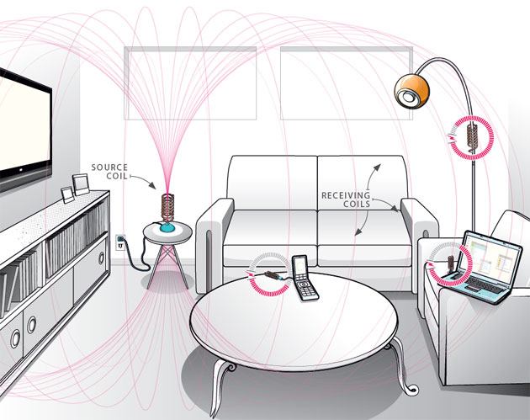
Wireless Power
$15.1 B Market by 2020*
eGaN FETs enable higher efficiency and operation at safer frequencies

Slide 19
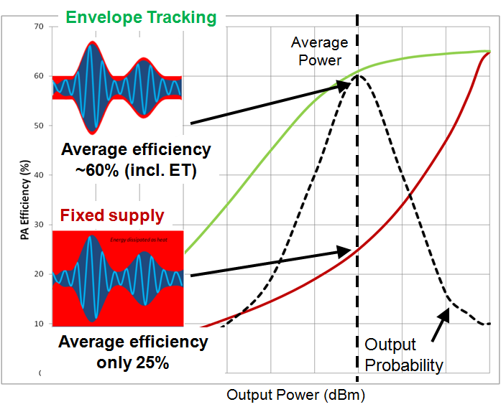
Envelope Tracking
LTE Infrastructure forecasted to grow to $24B in 2013*
Envelope Tracking can double base station efficiency

Slide 20
LiDAR - Pulsed Laser
$330M market estimate for 2011*
eGaN FETs enable faster and larger laser pulses
800 A

Slide 21
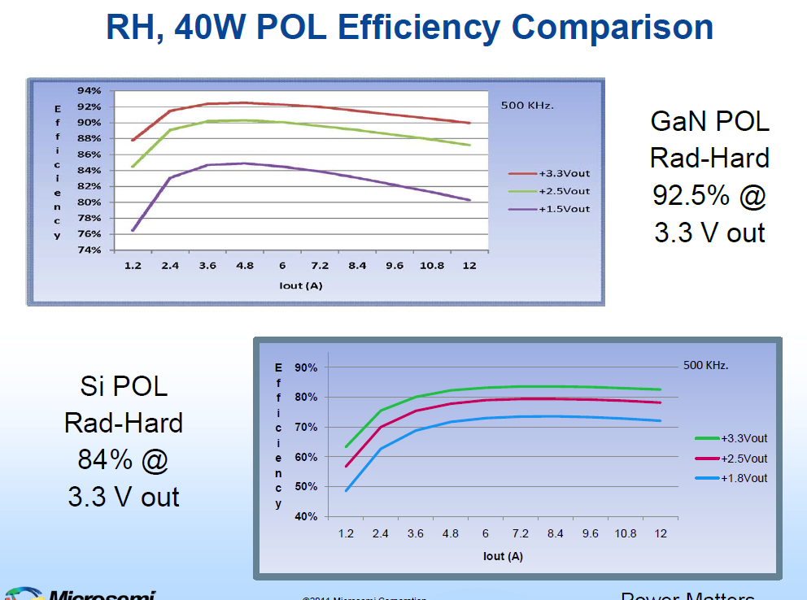
Rad Hard
$100M Market for Rad Hard MOSFETs
eGaN FETs withstand more than 10x radiation and enable higher system efficiency

Slide 22
Other Key Applications
Power Over Ethernet
RF Transmission
Network and Server Power Supplies
Power Factor Correction
Point of Load Modules
Solar Microinverters
Energy Efficient Lighting
Class D Audio

Slide 23
Making GaN Cost Effective

Slide 24
Silicon vs eGaN® FET Costs
2012
2015
Starting Material
same
same
Epi Growth
higher
~same
Wafer Fab
same
lower
Test
same
same
Assembly
lower
lower
OVERALL
higher
~same

Slide 25
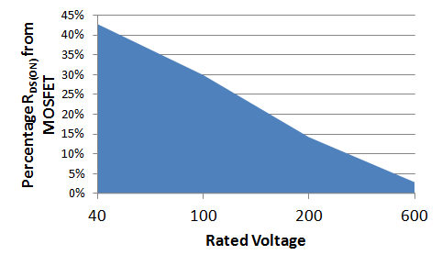
Cascode vs Enhancement Mode
Cascode devices combine a depletion mode GaN transistor with a low voltage enhancement mode MOSFET
Drain
Gate
Source
Notes:
The cascode configuration transforms a depletion mode device into an enhancement mode device by putting a MOSFET in series with a GaN transistor. In addition to adding cost, size and added packaging, this solution adds to the total system R_{DS(ON)} . At higher voltages, the added R_{DS(ON)} becomes small.

Slide 26
Establishing GaN’s Reliability

Slide 27
eGaN® FETs are Reliable
27

Slide 28
Summary
eGaN® technology is disruptive
EPC has been in production for 3 years
GaN-enabled applications have surfaced
GaN infrastructure is developing
eGaN FET costs are coming down rapidly
eGaN FETs are reliable
GaN adoption rate is accelerating

Slide 29


The end of the road for silicon…..
is the beginning of the eGaN FET journey!

